Slide 1
Query Processing and Optimization

Slide 2
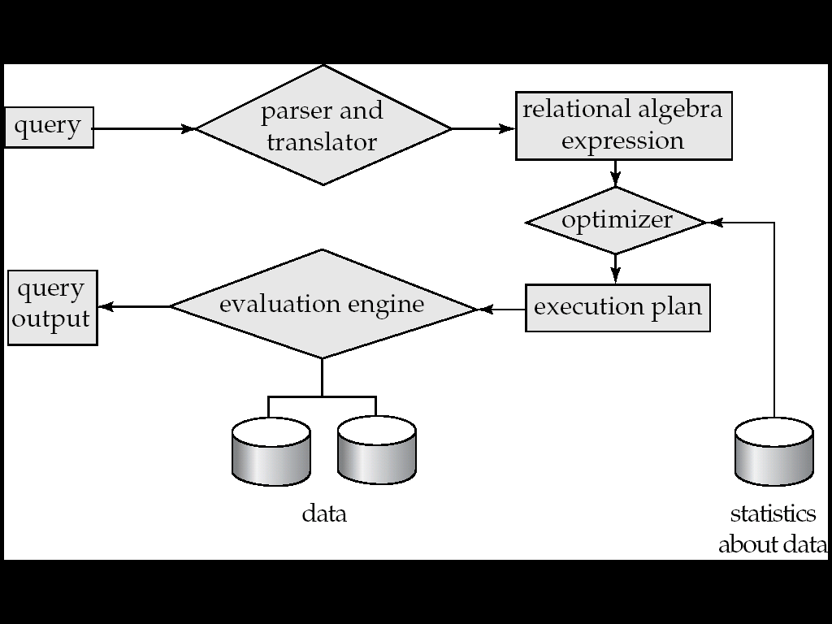
Basic Steps in Query Processing
1. Parsing and translation
2. Optimization
3. Evaluation

Slide 3
Basic Steps in Query Processing
Step 1: Parsing
In this step, the parser of the query processor module checks
the syntax of the query,
the user’s privileges to execute the query,
the table names and attribute names, etc.
The correct table names, attribute names and the privilege of the users can be taken from the system catalog (data dictionary).
Step 2: Translation
If we have written a valid query, then it is converted from high level language SQL to low level instruction in Relational Algebra

Slide 4
Translation Example
Query: select salary
from instructor
where salary<75000;
This can be translated into either of the following relational-algebra expression
σ salary<75000(∏ salary(instructor))
∏ salary (σ salary<75000 (instructor))

Slide 5
Tree Representation of Relational Algebra
∏ salary (σ salary<75000 (instructor))
π_{salary}
σ_{salary<7500}
instructor

Slide 6
Making An Evaluation Plan
Annotate Query Tree with evaluation instructions:
The query can now be executed by the query execution engine
π_{salary}
σ_{salary<7500}
use index 1
instructor

Slide 7
Basic Steps in Query Processing
Step 3: Optimizer
Optimizer uses the statistical data stored as part of data dictionary
The statistical data are information about the size of the table, the length of records, the indexes created on the table, etc
Optimizer also checks for the conditions and conditional attributes which are parts of the query.
Step 4: Execution Plan
A query can be expressed in many ways.
The query processor module, at this stage, using the information collected in step 3 to find different relational algebra expressions that are equivalent and return the result of the one which we have written already.

Slide 8
Basic Steps in Query Processing
Step 5: Evaluation
Though we got many execution plans constructed through statistical data, though they return same result (obvious), they differ in terms of Time consumption to execute the query, or the Space required executing the query. Hence, it is mandatory choose one plan which obviously consumes less cost.
At this stage, we choose one execution plan of the several we have developed. This Execution plan accesses data from the database to give the final result.

Slide 9
Query Evaluation Plan
In order to fully evaluate a query, the system needs to construct a query evaluation plan.
The annotations in the evaluation plan may refer to the algorithms to be used for the particular index or the specific operations.
Such relational algebra with annotations is referred to as Evaluation Primitives. The evaluation primitives carry the instructions needed for the evaluation of the operation.
Thus, a query evaluation plan defines a sequence of primitive operations used for evaluating a query. The query evaluation plan is also referred to as the query execution plan.
A query execution engine is responsible for generating the output of the given query. It takes the query execution plan, executes it, and finally makes the output for the user query

Slide 10
Optimization
The cost of the query evaluation can vary for different types of queries. Although the system is responsible for constructing the evaluation plan, the user does need not to write their query efficiently.
Usually, a database system generates an efficient query evaluation plan, which minimizes its cost. This type of task performed by the database system and is known as Query Optimization.
For optimizing a query, the query optimizer should have an estimated cost analysis of each operation. It is because the overall operation cost depends on the memory allocations to several operations, execution costs, and so on.
Finally, after selecting an evaluation plan, the system evaluates the query and produces the output of the query

